Slide 1


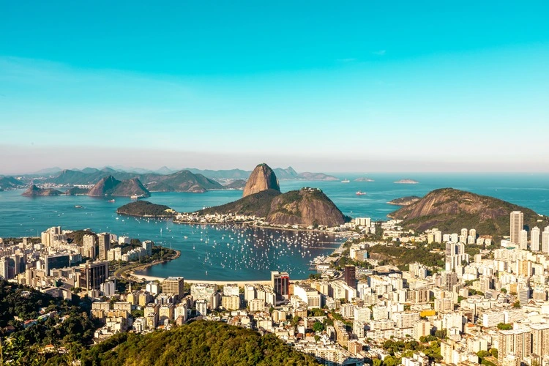
Advancing Public-Interest AI In Brazil and Latin America
Institutional Pathways, Governance Gaps, and Strategic Opportunities for Fundação BRAVA
Prepared for Fundação BRAVA
Columbia SIPA Capstone Team
Sanjana Aravamudhan
Bojana Starcevic
Jamal Washington
Jonathan Echavarria
Mardiantika Watubun
Anshima Varma
April 2026

Slide 2

Why Study Public Interest AI?
WORKERS OVERSEEING
AN AI SYSTEM
12
ADMINISTERING BENEFITS TO
million
BRAZILIANS
28
BRAZIL’S INSS AUTOMATED BENEFIT SYSTEM

Slide 3

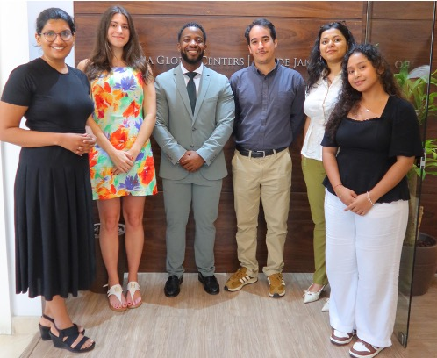
Overview and Introduction
About BRAVA Foundation
About the Team
A non-profit organization established in 2000, aimed at building a more efficient, equitable, and resilient society
BRAVA’s efforts are focused:
Enhancing public sector management capabilities
Supporting the development of innovative and high-impact initiatives
Systematizing and disseminating evidence-based best practices
BRAVA aims to understand where philanthropic investment, partnership-building, and convening can advance public-interest AI in Brazil.
Sanjana Aravamudhan, Bojana Starcevic, Jamal Washington, Jonathan Echavarria, Anshima Varma, Mardiantika Watubun

Slide 4
Research Objective
Central Research Question
What are the highest-value initiatives and strategic steps BRAVA Foundation can undertake to maximise its contribution to advancing AI for public interest in Brazil?
Secondary Research Questions
1
2
3
4
How do BRAVA’s current capabilities and priorities towards AI position it amongst its peers within the AI ecosystem of Brazil?
What is the current AI landscape in Brazil? Who are the key stakeholders?
What is public interest AI, and how should BRAVA define and approach work in this field?
Which thematic areas of AI in the public sector offer the greatest opportunity for BRAVA to contribute meaningfully?
5
6
7
8
What are the overall trends of AI in Brazil, looking specifically at investment and philanthropic flows?
Which sub-sectors demonstrate gaps between intended policy and current initiative implementation? What are some of the gaps?
What are some of the global and regional best practices within the AI for the public goods sector?
How do other organizations approach their funding models and advocacy strategies, and what can BRAVA learn from them?

Slide 5
Good Governance Pillars
Equity and Inclusive Access
AI systems should reduce, not reinforce structural inequalities
01
Institutional Capacity and Readiness
Governments need the technical, regulatory, and operational ability to deploy AI responsibly
Accountability & Democratic Oversight
Governance must expand accountability and prevent biases and injustices
Youth and Societal Well-Being
AI systems should safeguard youth well-being and support healthy cognitive, social, and civic development
Transparency
Public-actors must be able to understand, explain, and redress AI based decisions
Public Value
AI use in public systems should be demonstrably aligned with societal benefit
02
03
04
05
06

Slide 6
Recommendations Preview
Fund applied policy research on AI governance failures in Brazil’s public sector​
Provide multi-year institutional funding for civil society AI oversight and accountability ​
Support data governance and interoperability infrastructure​
Recommendation
#1
Recommendation
#2
Recommendation
#3
Recommendation
#4
Recommendation
#5
Fund executive education for state and municipal public managers on AI governance​
Support responsible AI adoption in public education with a youth well-being lens ​

Slide 7
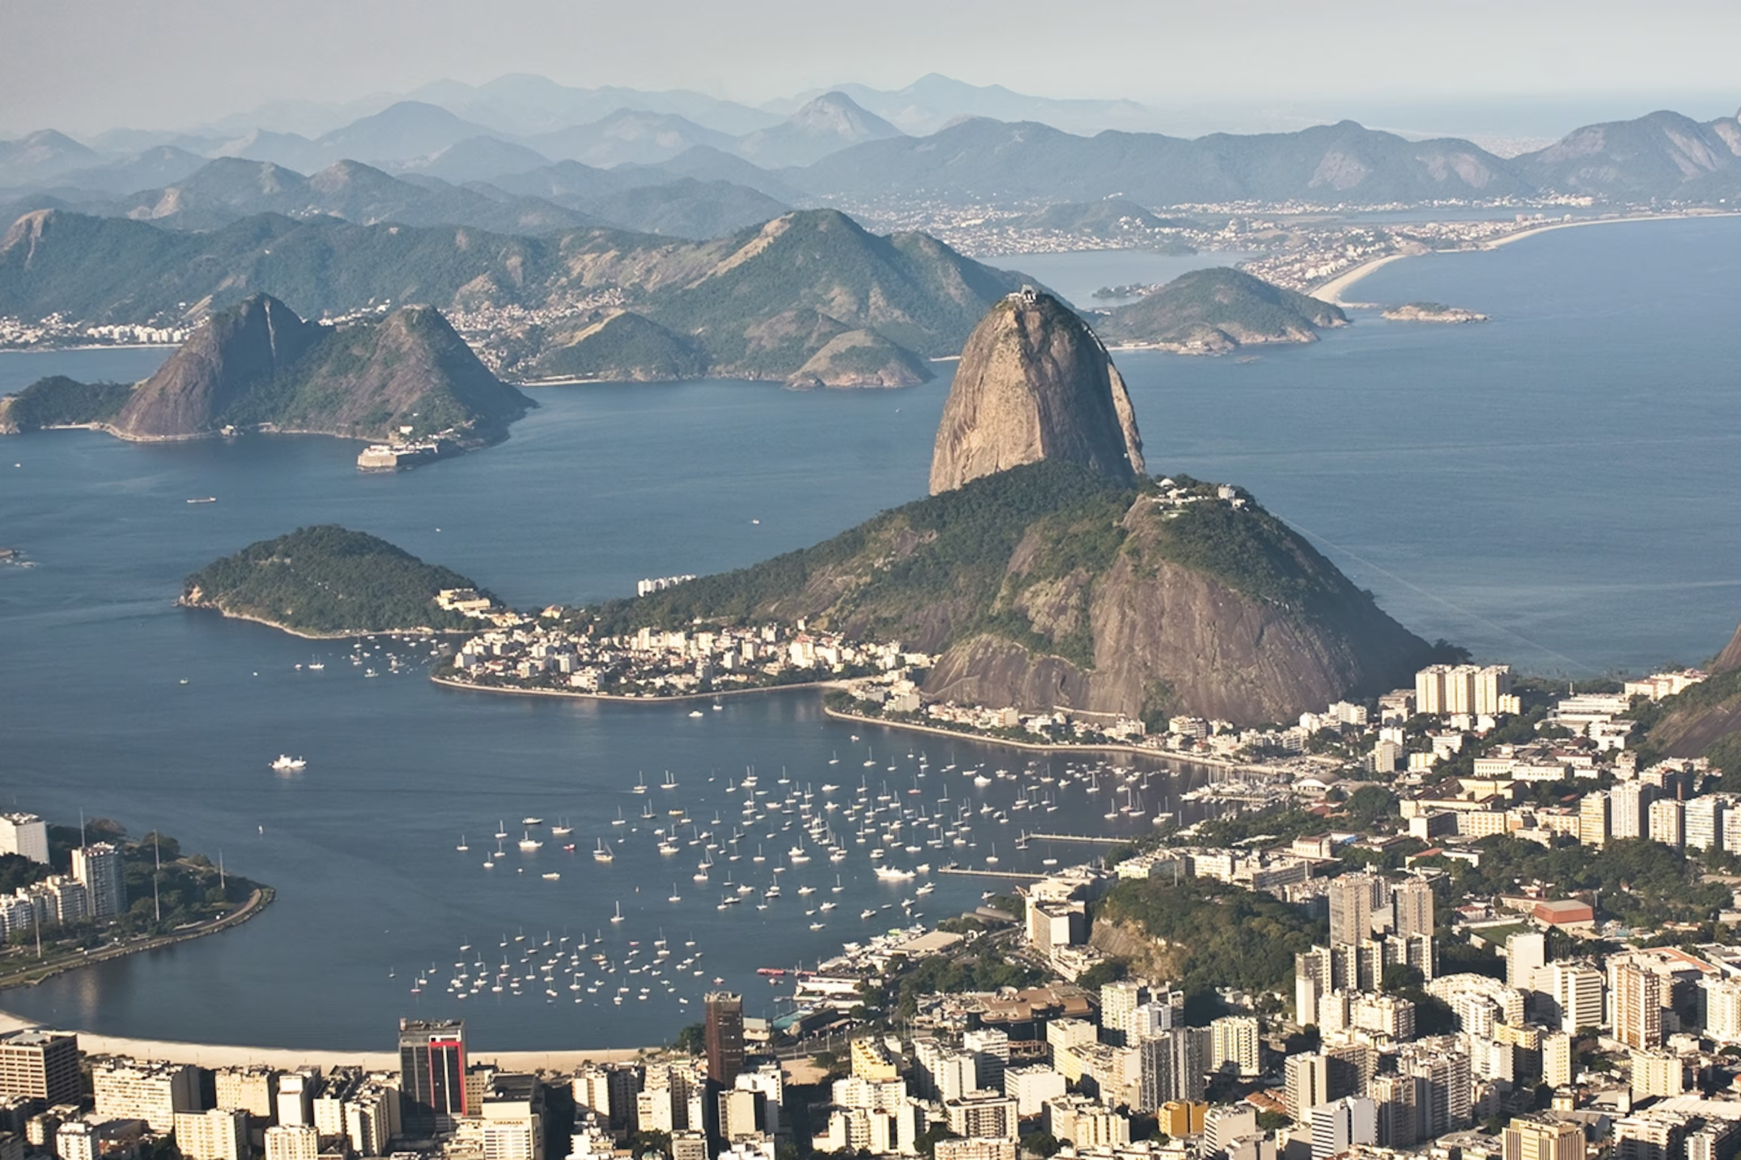
Methodology & Approach

Slide 8
Research Design
Reviewed Brazil’s key AI regulations (PL 2338/2023, LGPD, EBIA)
Mapped cross-sector landscape
Applied global AI readiness frameworks such as OECD, Oxford Insights, etc to define best practices
01
MAP
Established the landscape of public-interest AI in Brazil to identify strengths and structural gaps.
02
8 public-sector AI use cases across 4 partnership models
ASSESS
6 governance pillars for evaluation
3 global benchmarking examples
Desk research findings were validated through stakeholder interviews.
Identified intervention areas: institutional capacity, data governance, and civil society strengthening
Mapped near-term, and longer-term impact opportunities
Defined an engagement strategy for BRAVA
03
3 client interviews
16 global external in-depth interviews
RECOMMEND
Translated findings into targeted investment recommendations.

Slide 9
Secondary Research Approach
1
2
3
Key Frameworks Utilized
Variety of Sources Assessed
Interview Functions Identified
Applied leading global frameworks to assess Brazil’s AI ecosystem and readiness.
Utilized these to construct a partnership evaluation framework based on governance best practices:
Oxford Insights Government AI Readiness Index
OECD Framework
UNESCO Readiness Assessment Methodology (RAM)
Built a reliable secondary-source repository to support comprehensive mapping of Brazil’s AI landscape.
Key categories of sources included:
International governance frameworks and index reports
Legislative and regulatory documents
Academic and applied research
Internal BRAVA documents
Utilized secondary to research shortlist target interviewees and design questionnaires across three functions:
Validated key findings on Brazil’s AI landscape, gaps, and priority sectors
Benchmarked global funders to assess investment and philanthropic trends
Engagement opportunities identified by assess potential partners against BRAVA’s priorities

Slide 10
Primary Research Approach
Stakeholder Identification
Categories: 1) Government; 2) Civil Society; 3) Private Sector; 4) Philanthropic Actors
Identified based on existing constraints in Brazil: fragmented governance, limited expertise, underdeveloped oversight capacity
Total: 16
Questionnaire Development
Developed around the 6 governance pillars of public-interest AI
Tailored for each stakeholder category
Aligned with BRAVA’s institutional mission and impact framework
Confidentiality and Attribution
Option to remain anonymous: name not to be mentioned across report and appendix
Interviewers must ask for consent before recording
Option to remain off-the-record: no recording
For all interviews
In-Country
Fieldwork
Cities Visited: Rio de Janeiro & São Paulo
Value to Project: Insight into client engagement with Insper and Columbia Global Center, understanding of Brazilian working culture, and assessment of on-the-ground AI adoption and use

Slide 11
Development of Partnership Evaluation Framework
In-depth interviews with BRAVA team
Evaluation Criteria
1
Equality and Inclusive Access:
Does the program include measures that promote equitable AI in Brazil?
2
Transparency
Does the program include transparency measures for use of AI systems or AI-related advocacy?
=
3
Accountability and Democratic Oversight
Does the program include accountability measures for use AI systems or AI-related advocacy?
4
Building Institutional & Social Capacity
Does the program include objectives to build institutional and social capacity for responsible AI use?
5
Financial Sustainability
Does the program demonstrate financial viability, and room for co-funding opportunities?
Global and regional best practices on good governance of AI
6
Technical Capability and Track Record
Does the partner demonstrate technical capability and credibility?
7
Institutional Strength
Does the partner demonstrate organizational stability, operational credibility, and transparency?
Program level criteria
Partner level criteria

Slide 12
Methodology Limitations
3
3
4
2
Heavy Reliance on Secondary Sources
Geographic and Organizational Skew
5
The analysis relies on credible secondary sources but may not fully reflect on-the-ground realities
Interviews focused on São Paulo and Rio, thus perspectives from other regions and local actors are underrepresented
Limited Coverage of Global Philanthropic Actors
Analysis of major global funders relied on public information rather than direct input, so the philanthropic is only partially captured.
The Election Year Constraint
Brazil’s 2026 pre-election climate limited criticism, so primary data may understate political and institutional issues
1
6
Incomplete Public-Sector Interview Coverage
Interviews skewed toward São Paulo and Rio, leaving federal bodies like ANPD and MCTI underrepresented
Short Monitoring Duration
The study reflects a single point in time, and ongoing regulatory changes may alter the landscape before implementation

Slide 13
Landscape Analysis

Slide 14
Landscape Analysis: Key Actors
Brazil’s AI Ecosystem
Government
Philanthropy
Civil Society
Academia
Private Sector
National Data Protection Authority
BRAVA Foundation
MegaEdu
INSPER
InvestSP
Lemann Foundation
InternetLab
Getulo Vargas Foundation (FVG)
Google Cloud
Ministry of Education
Ford Foundation
Instituto Decodifica
Microsoft
IMPA Tech
São Paulo Legislative Assembly
MacArthur Foundation
Nova Escola
McGovern Foundation
NIC.br/Cetic.br

Slide 15
Landscape Analysis: Constraint
Fragmented Governance
AI governance is split across at least six federal entities with limited coordination, no shared standards, and minimal oversight
1
No Coordination Mechanisms
2
Multi-stakeholder coordination occurs on an ad hoc basis, with no formal body responsible for ensuring consistency in AI standards across agencies or levels of government
3
Data Silos
Brazil’s public-sector data silos and lack of standardized data governance protocols results in less reliable and scalable AI systems
Public managers frequently lack capacity, resulting in vendor capture, as they are unable to evaluate AI vendor claims or define problems before procurement decisions, leading to external reliance
4
Institutional Capacity Gaps
5
Foreign Technology Dependence
AI ecosystem is reliant on infrastructure and models provided by international technology companies with design assumptions that do not always reflect Brazilian institutional realities.

Slide 16


Landscape Analysis: Intervention Modalities
1
Addresses the gap between Brazil’s regulatory ambition and operational execution by fostering:
Governance literacy
Leadership capacity
Strategic AI fluency
3 Intervention Modalities
for BRAVA
1. Institutional Capacity
& Technical Assistance
2
Addresses the interoperability gap in Brazil’s fragmented data systems by improving reliability and scalability of future AI deployments.
2. Data Governance &
Public Infrastructure
3
3. Civil Society &
Oversight Strengthening
Addresses the accountability gap by investing in civil society organizations that are technically credible and politically neutral.

Slide 17
Study Recommendations

Slide 18
Recommendations Overview
Recommendations are provided in a sequential manner, addressing Brazil’s two key constraints
Constraints are interlinked and require layered interventions, thus recommendations are divided across near-term and longer-term.
1. BRAVA’s Strategic Positioning & Priorities
2.Recommendation Logic
BRAVA works through civil society organizations, academic institutions, and training programs.
First priority for intervention: Modality 1 (Institutional Capacity & Technical Assistance)
Study Recommendations
3. Near-Term Investments
4. Longer-Term Investment
Durable investments positioned to be able to
begin immediately
Anchored in apolitical institutions and credible partners
Generates impact independent of the 2026 electoral cycle
Requires political stability and governance conditions that do not yet exist.
Ensures that BRAVA begins positioning now, however should not expect returns before the post-election environment stabilizes.

Slide 19
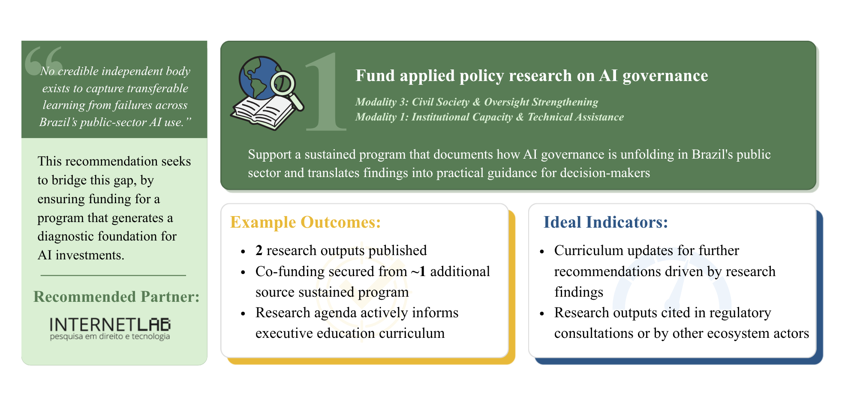
Recommendation 1
Near-Term

Slide 20
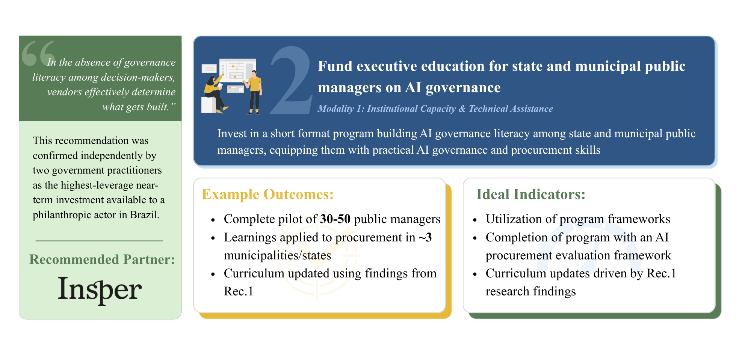
Recommendation 2
Near-Term

Slide 21
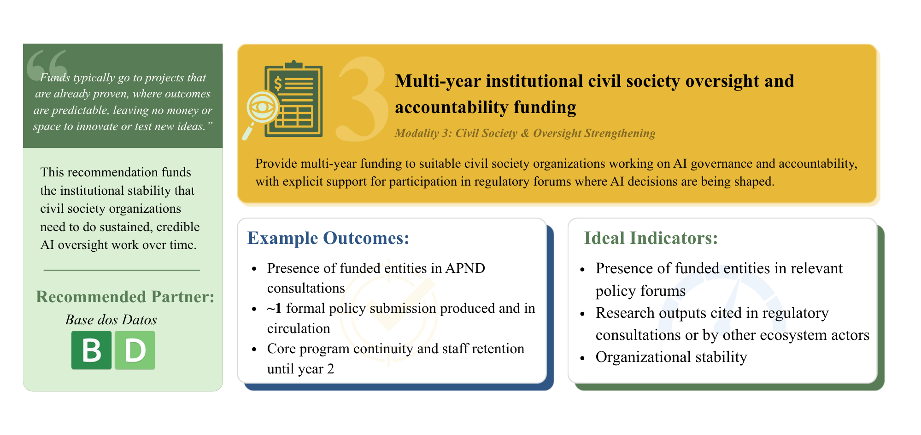
Recommendation 3
Near-Term

Slide 22
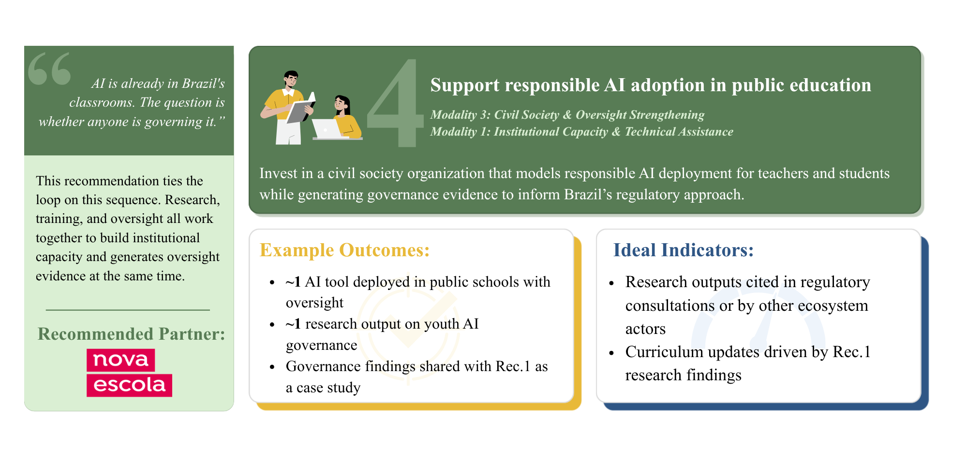
Recommendation 4
Near-Term

Slide 23
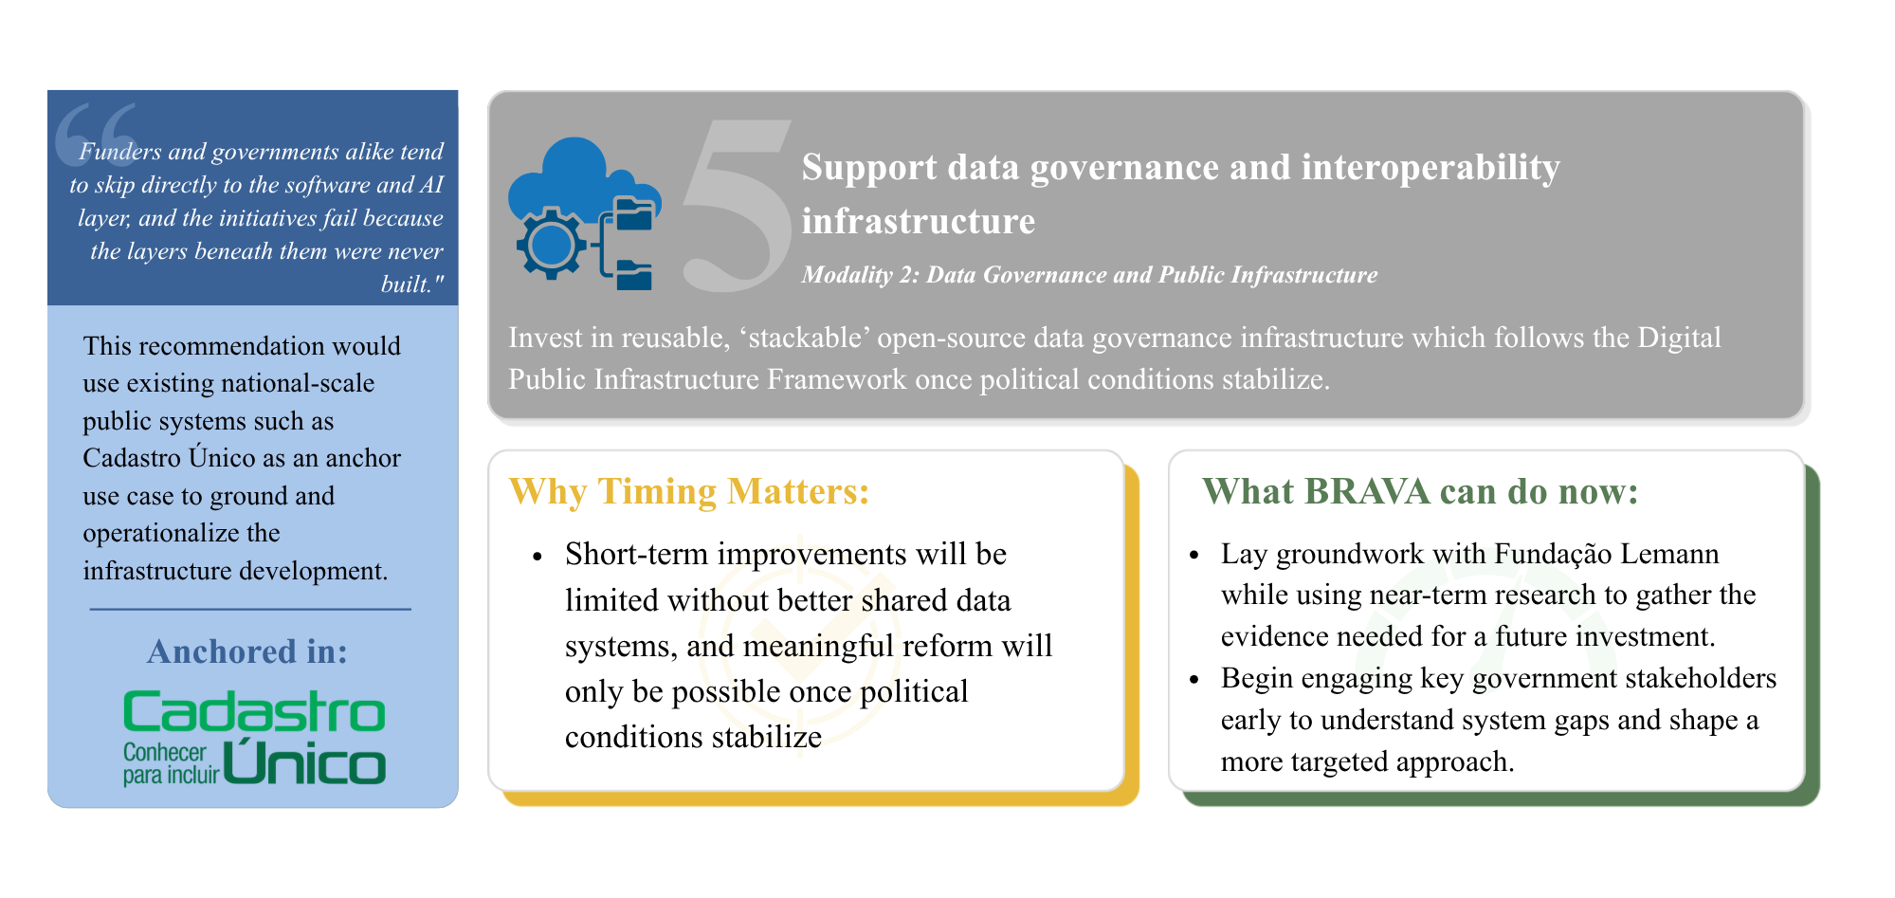
Recommendation 5
Longer-Term

Slide 24









Partnership Recommendations: Overview- (1/2)
3
Nova Escola (2.9)
[Professor ANE]
Insper (2.8)
Lemann Foundation
(2.7)
Recommendations
[Agile AI & Expert Connections]
[AI Alliance]
2.3
Base dos Dados (2.2) [BD Lab]
InternetLab (2.0)
2
NIC.br (2.1) [OBIA]
[Education & Surveillance Technology]
Score
InternetLab (1.9)
Instituto Decodifica (1.8)
MegaEdu (1.7)
[Luminate Project]
[Sectoral Impact of AI]
InternetLab (1.6)
[Connectivity Planning & Technical Assistance]
[Data Justice and Social Protection Policies]
FGV Direito Rio
(1.5)
[AI Hub]
1
Institutional Capacity and Technical Assistance
Data Governance and Public Infrastructure
Civil Society and Oversight Strengthening
Intervention Modalities

Slide 25
Partnership Recommendations: Deep Dive - (2/2)
Nova Escola
Insper
Lemann Foundation
InternetLab
Program supports public education by leveraging AI to provide lesson planning support in public schools
Ensures transparency and accountability by employing an LLM-as-a-judge system to evaluate AI generated content
Program places students in structured sprints with partners to develop applied AI solutions for real-world problems
Demonstrates strong co-funding potential, with support from the Becker-Friedman Institute and investment from TCS
A co-funding program that evaluates and funds AI solutions for public education in Brazil
Demonstrates a comprehensive approach to scale, designing sustainability frameworks from the beginning.
Project evaluates risks, justifications and policies of facial recognition and surveillance in public schools
Demonstrates a strong track record of work on technology and human rights, with a transparent methodology
Score: 2.9
Score: 2.8
Score: 2.7
Score: 2.0
Demonstrates SIPA team’s recommendation, outside of the scoring matrix. InternetLab’s programs demonstrate a strong alignment with BRAVA’s strategic priorities. InternetLab and its project received a lower score due to reliance on limited secondary research and the absence of an interview.

Slide 26
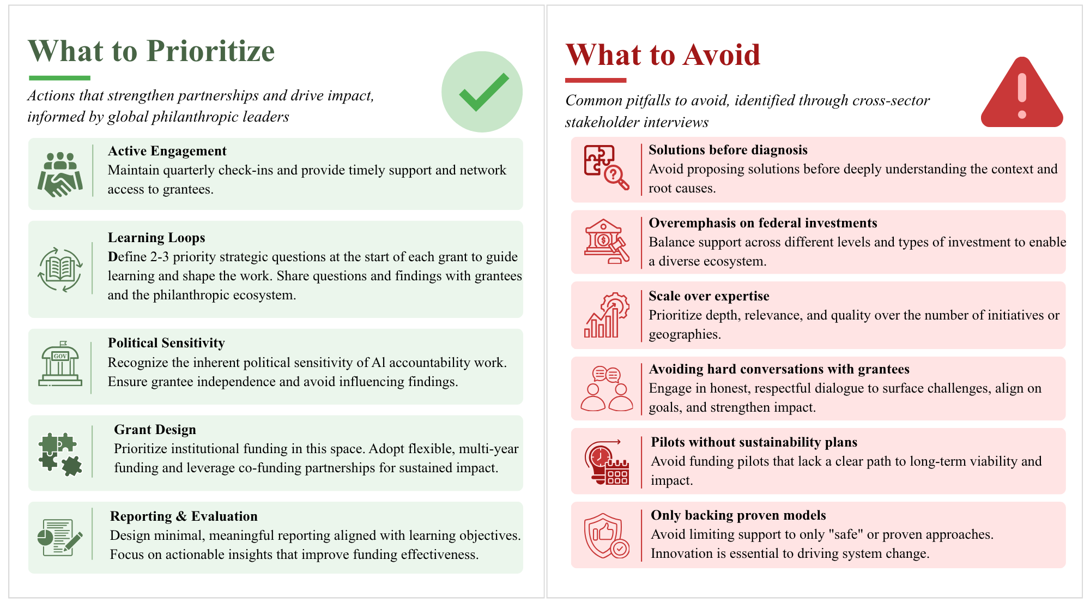
Key Considerations for Engagement

Slide 27
Acknowledgements
This study was made possible through the contributions of the practitioners, researchers, and institutional leaders who gave their time, shared their expertise, and trusted our team with their candid views on Brazil's AI landscape. We would like to directly thank the following interviewees for their time and insights:
Manuel Bonduki, Ministry of Education (MEC)
Guilherme Cintra & Tiago Maluta Fundação Lemann
Manuella Maia Ribeiro, NIC.br
Fabio Roberto de Miranda & Gustavo Macedo, Insper
Laryssa Nunes & Claudio Mendes, Instituto Decodifica
Ana Ligia Scachetti, Nova Escola
Thomaz Galvão, MegaEdu
Marianna Sampaio, São Paulo Legislative Assembly
London Swift, Omidyar Network
Julia Henriques, Alandar
Senior official, ANPD (anonymous participation)
Maria Luiza Paranhos & the Columbia Global Center Rio team
We are also grateful to:
Jen Weedon, our Faculty Advisor, for her steady guidance and support from start to finish.
Jenny McGill and Vida Herling, for their logistical support throughout this project.
Finally, a special thank you to Fundação BRAVA: Letícia Piccolotto Ferriera, Evelyn Hirose, and Mariana Soares – for their trust, engagement, and partnership throughout this study. Their openness in sharing BRAVA's mission, operating model, and strategic priorities made this work possible, and their commitment to evidence-based institutional change in Brazil is what motivated it.

Slide 28
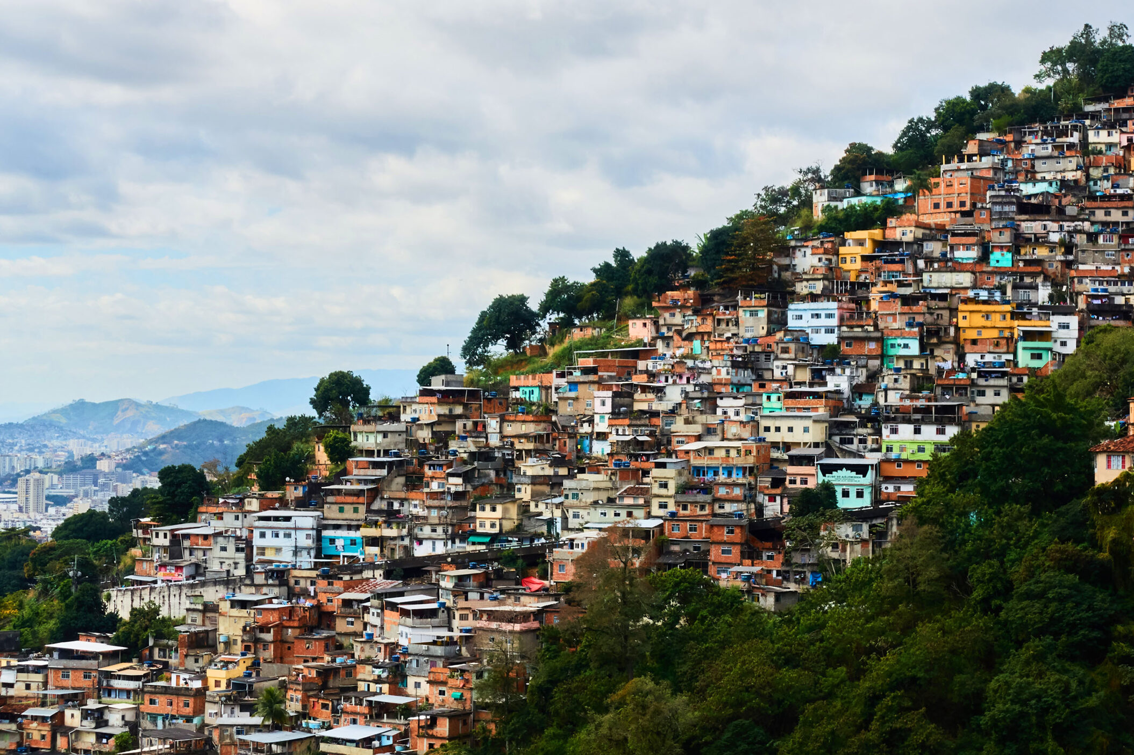
Questions
&
Answers

